Slide 1
Online Portfolio Consultation Meeting
GEF IW:LEARN Small Island Developing States (SIDS) Webinar
20 November 2024
Laverne Walker, UNEP Cartagena Convention Secretariat

Slide 2
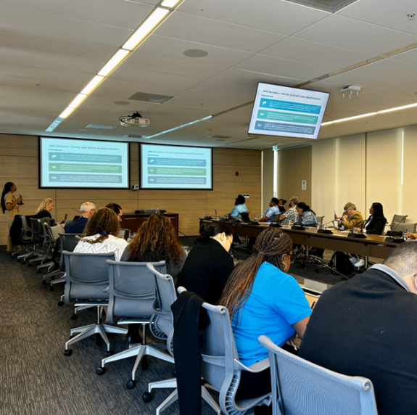
Workshop Overview
IWC 10 Preconference workshop
Date: 21 September 2024
Venue: CAF, Montevideo Uruguay
Participants: Country representatives, Project Managers, Intergovernmental Organisations, Non-Governmental Organisations (approx. 30 participants)
Regions represented: African, Caribbean, Pacific SIDS

Slide 3
Workshop Objectives
To strengthen the impact of GEF funded SIDS projects at both the regional and inter-regional level
To increase knowledge and awareness of the needs of SIDS, in particular the priorities adopted by the GEF: The Blue Economy, Integrated Resource Management from Ridge-to-Reef, Protected Areas, and Climate Resilience
To collectively learn from each other and gain exposure to knowledge within and between the regions linked to GEF objectives
To solicit input on the two-fold assessment that will inform the development of the SIDS Hub, including a stakeholder-driven assessment of needs, gaps, and priorities of the SIDS GEF IW project community and other focal area projects

Slide 4
Identification of SIDS Priorities from ABAS that could be considered under GEF 9
Promote sustainable ocean-based economies
Achieve gender equality, empower youth and leave no one behind
Develop integrated water resources management
Urgently take action on climate change
Conserve and sustainably use the ocean and its resources
Conserve, restore and sustainably use biodiversity

Slide 5
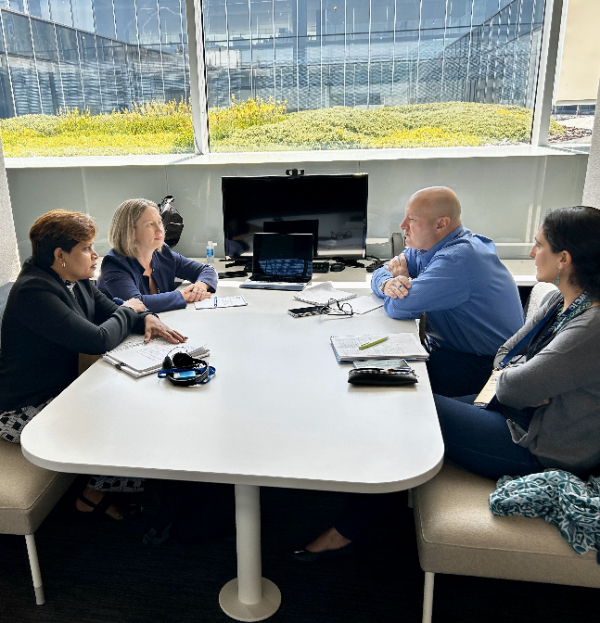
Blue Carbon Thematic Group Recommendations
Focusing on small-scale and multi-state projects - prioritizing smaller, community-driven projects and multi-state collaborations to ensure greater inclusivity and local relevance.
Innovative finance for adaptation and ecosystem benefits - investigating new financing models that support not only carbon sequestration but also broader ecosystem services, such as adaptation and biodiversity conservation.

Slide 6
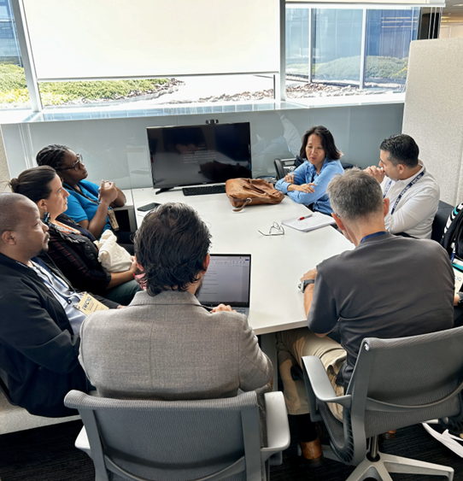
Blue Economy Thematic Group Recommendations
Developing a new model for long-term sustainable finance - This could come through encouraging blended finance, for example the green banks model piloted by AfDB in Africa.
Increasing the proportion of funding for continuous capacity development, including across different stakeholder groups (NGOs, academia, etc).

Slide 7
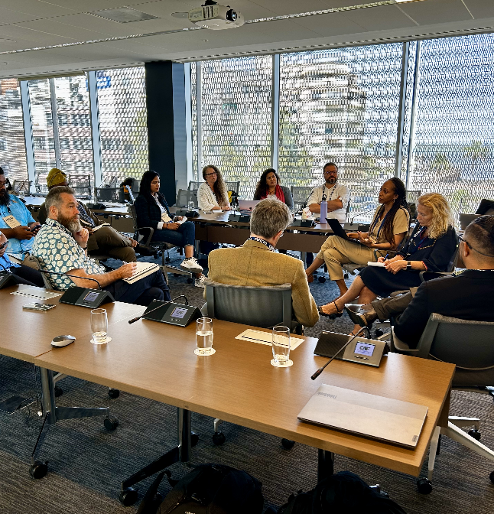
Source to Sea Thematic Group Recommendations
Increasing tangible benefits to participating communities, resulting in the sustainability of the project outputs.
Incorporating capacity development components, particularly for government agencies to ensure long-term institutional capacity building.

Slide 8
Other topics discussed during the workshop
SIDS Twinning Portal
Knowledge gaps and priorities for development of a training strategy
Priority Needs for regional and inter-regional training workshops
IW LEARN SIDS Hub

Slide 9
Description of the GEF Portfolio support to SIDS
Asha Singh, PhD
Consultant –IW LEARN IOC/UNESCO

Slide 10
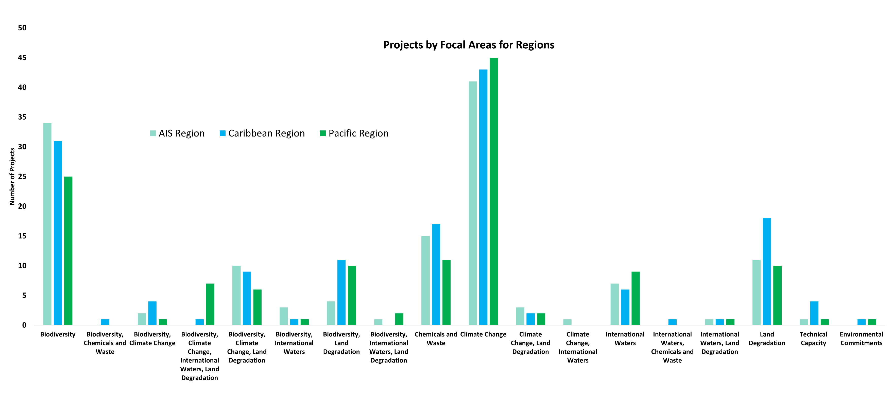
Financial Flow

Slide 11
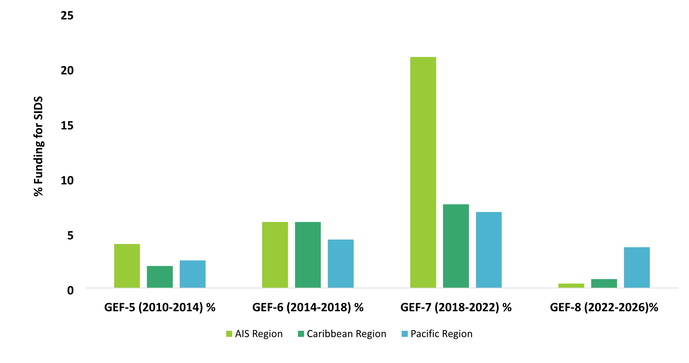
Financial Flow

Slide 12
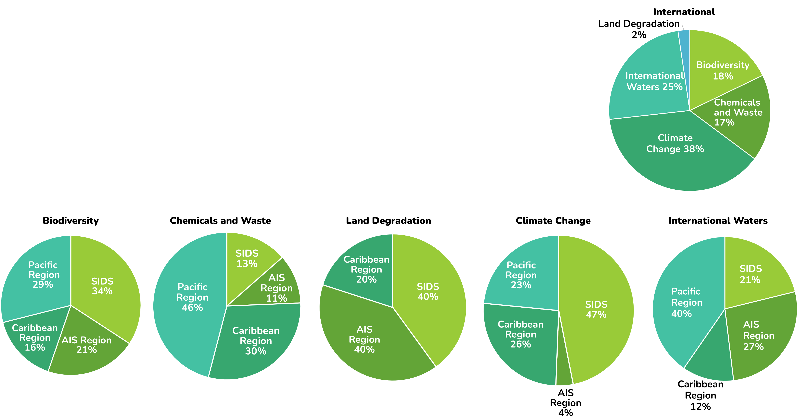
Information Materials

Slide 13
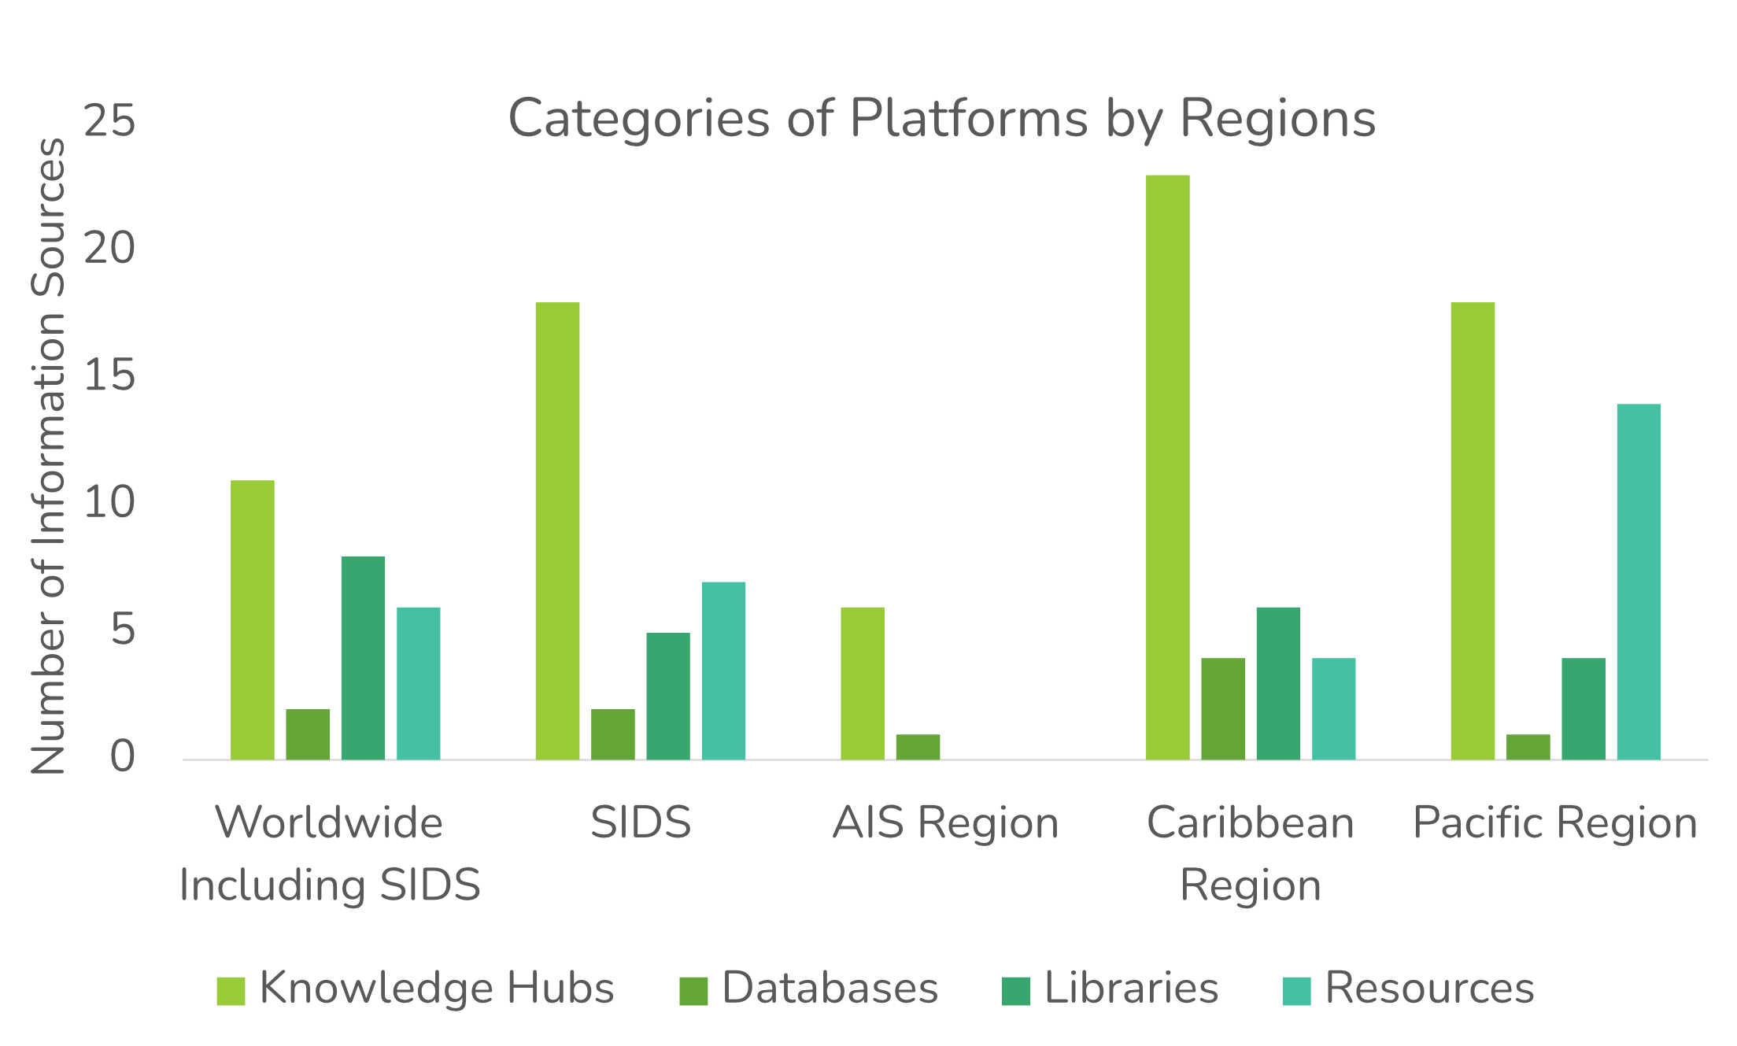
Information Platforms

Slide 14
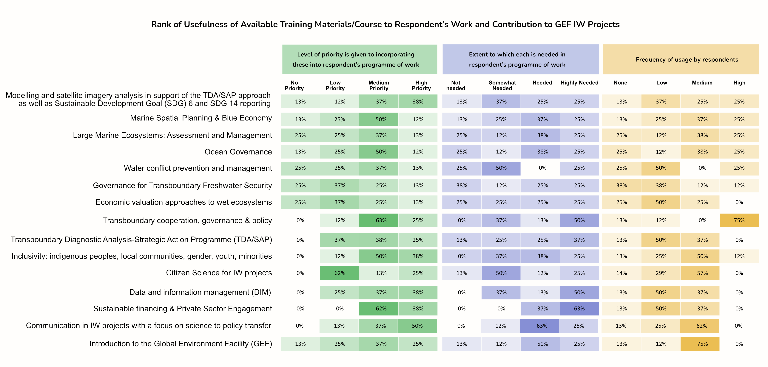

Slide 17
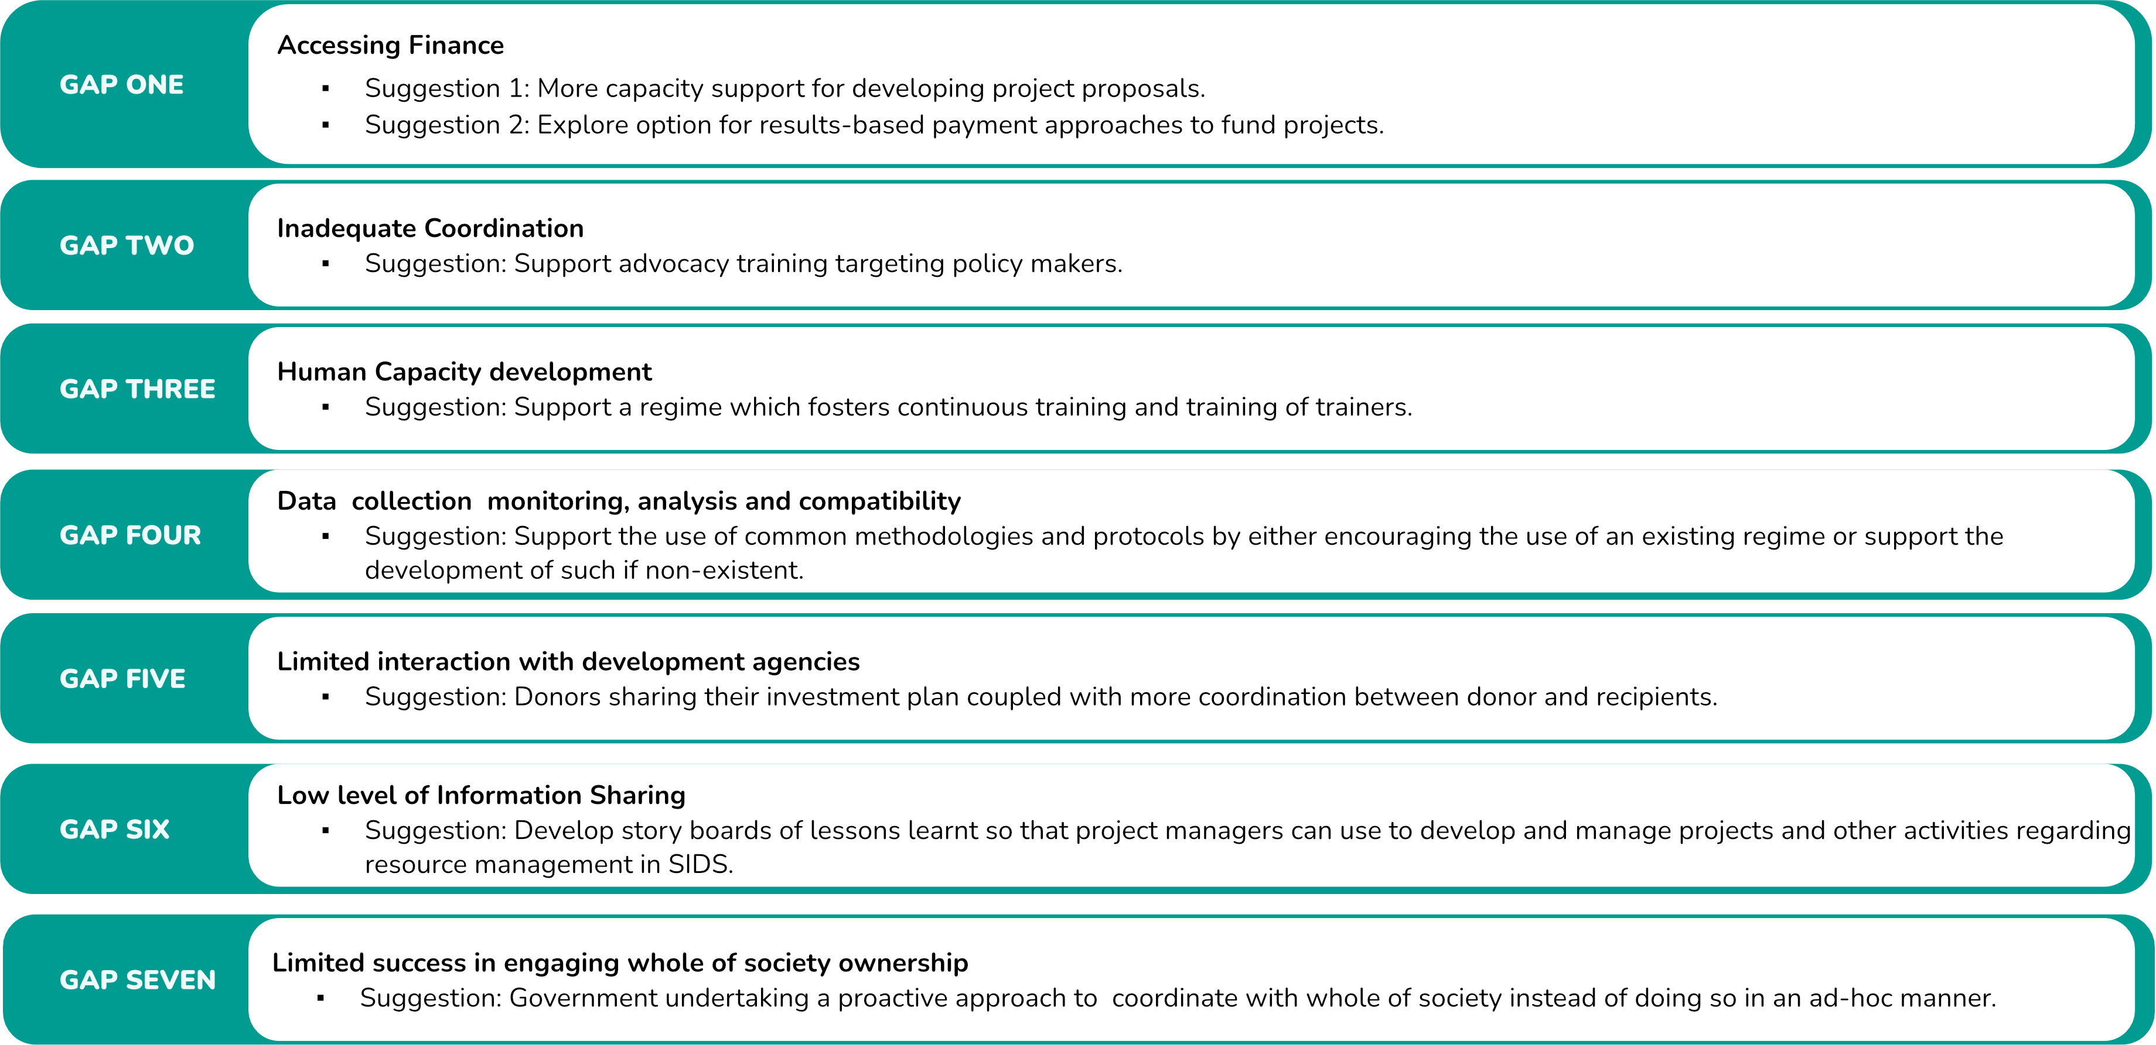

Slide 19
A SIDS-SIDS Green-Blue Economy Knowledge Transfer Hub
October 2023

Slide 20
Background
Feasibility Study of the Establishment of a SIDS-SIDS Green-Blue Economy Knowledge Transfer Hub (Dr. Mark Griffith, 2021; UNITAR)
Decision 8 - XXII Meeting of the Forum of Ministers of the Environment of Latin America and the Caribbean “on the Environmental Dimension of SIDS (February 2021)
Partnership for Action on Green Economy (PAGE)-Barbados Programme
Significant impetus for the shaping present concept in partnership with UWI
Mid-sized GEF project (< US$2 million) Demonstrate of proof-of-concept viability
Utilize residual GEF7 resources
GEF has offered favorable signal for support
Regional initiative with 2 national demonstration/focus countries
Barbados and Grenada
Notes:
Thank Hon. Adrian R. Forde Minister of Environment, National Beautification and the Blue and Green Economy President of the 22 Forum of Ministers
Need to big-up Grenada

Slide 21
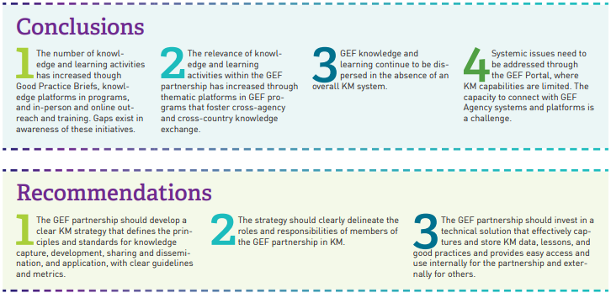
Evaluation of Knowledge Management (KM) in the GEF 2020
https://www.gefieo.org/sites/default/files/documents/synopsis/km-study-2020-learnings.pdf

Slide 22
In the Caribbean region…barriers to successful knowledge management (KM) application
GEF findings relevant to Caribbean!
Absence of a sound knowledge of successful green learning elements implemented through GEF projects in CSIDS; countries unable to utilize knowledge in Post-COVID-19 Green-Blue Recovery
notwithstanding there is global consensus that the best response of Building Back Better in the Post COVID-19 era is via a Green and Sustainable Recovery.
Absence of evidence-proven application of green learning elements poses significant constraints in designing a Green Sustainable Post COVID-19 Recovery Response.
Absence of a methodology and system for documenting successfully implemented green solutions done through GEF project investments
Allowed to continue means that CSIDS (GEF) would not be reaping maximum benefits of investments

Slide 23
Opportunities
Caribbean
Cartagena Convention Secretariat/Caribbean Regional Seas Programme
CARICOM institutions; various KM platforms
OECS Knowledge Centre
Partnership Initiative on Sustainable Land Management (PISLM)

Slide 24
Project overview: Demonstration of a Caribbean Mechanism Toward Establishment of a SIDS-SIDS Green-Blue Economy Knowledge Transfer Hub
Duration: 3 years
Implementing agency: UNEP
Executing agency: University of the West Indies (UWI), Cave Hill Campus
Project cost: GEF grant US$1.78 million; Co- financing: US$3.5 million
Mid-Sized Project (GEF grant US$2 million and below)
Barbados and Grenada
GEF focal area alignment: Land degradation
Main programming directions:
LD-2-5 Create enabling environments to support scaling up and mainstreaming of SLM and LDN
On GEF website: https://www.thegef.org/projects-operations/database?project_search=10992

Slide 25
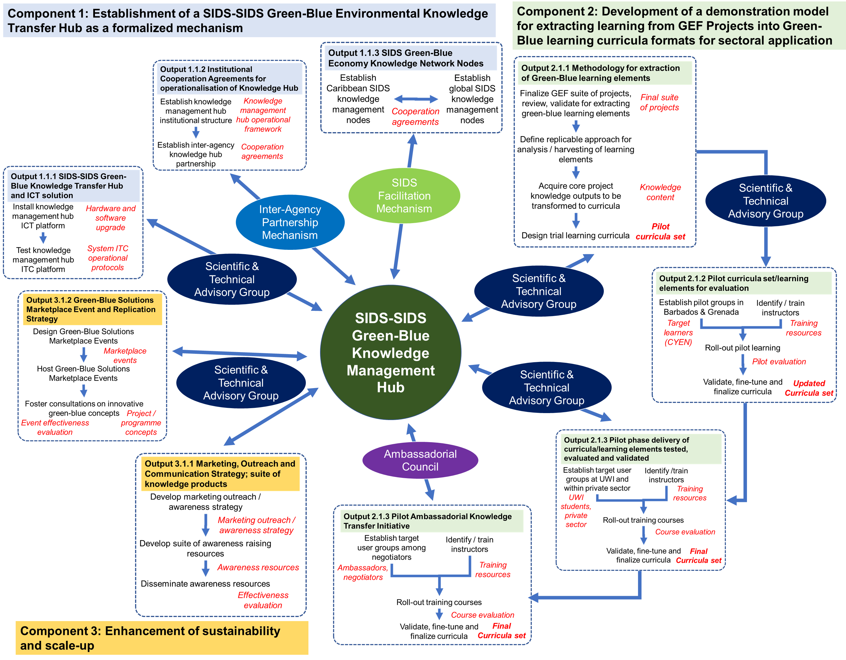

Slide 26
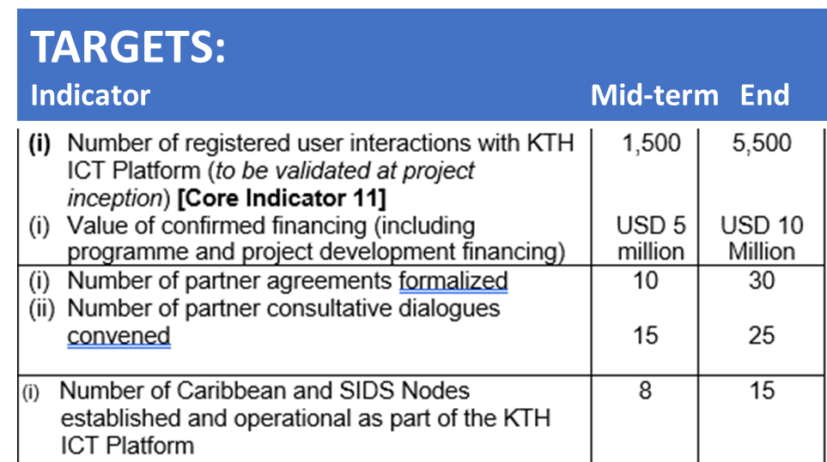
Component 1: Establishment of a SIDS-SIDS Green-Blue Environmental Knowledge Transfer Hub as a formalized mechanism
Output 1.1.2. SIDS-SIDS Green-Blue Knowledge Transfer Hub (KTH) and ICT solution for evaluation and endorsement of lead partners
Output 1.1.2. Institutional Cooperation Agreements for operationalisation of the SIDS-SIDS Green-Blue Knowledge Transfer Hub with partner agencies signed by partner organizations
Output 1.1.3. SIDS Green-Blue Economy Knowledge Network Nodes for the strengthening of inter- and intra-regional cooperation between SIDS

Slide 27
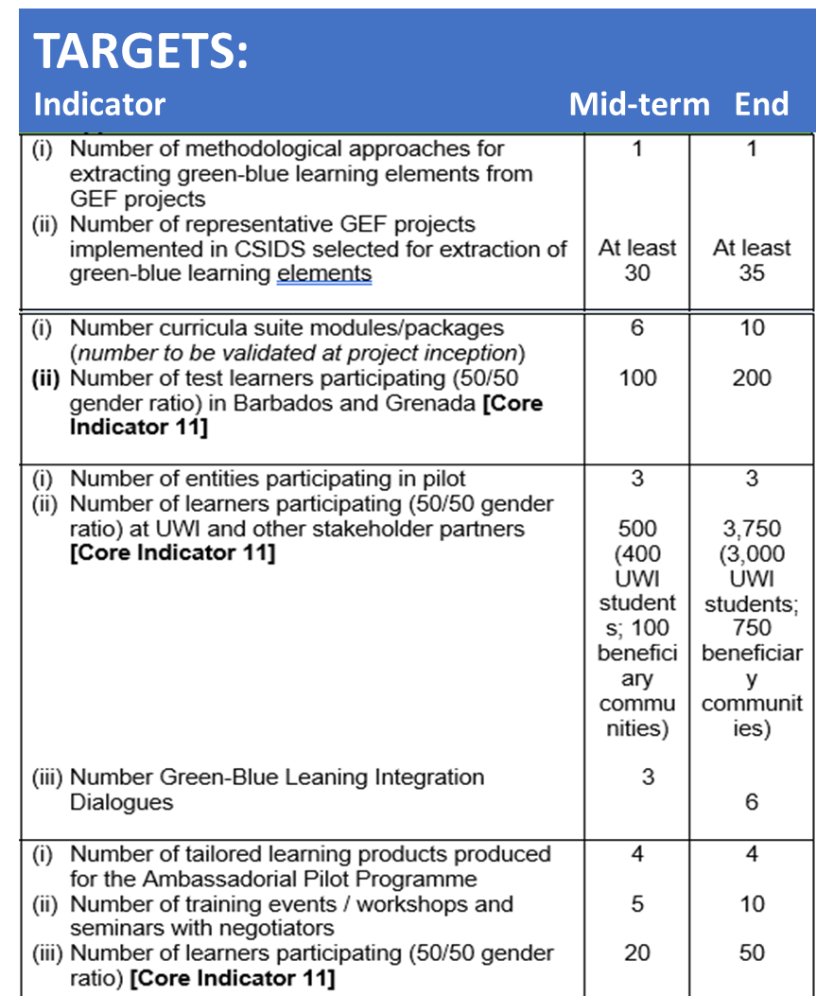
Component 2: Development of a demonstration model for extracting learning from GEF Projects into Green-Blue learning curricula formats for sectoral application
Output 2.1.1: Methodology and system for analysis of and extraction of Green-Blue learning elements developed from GEF projects implemented in CSIDS for evaluation by KT Hub partners
Output 2.1.2 Pilot curricula set/learning elements extracted from GEF projects (on sector-based environmentally sound and innovative technologies and policy instruments) designed for multiple delivery platforms for evaluation by KT Hub partners
Output 2.1.3 Pilot phase delivery of curricula/learning elements tested, evaluated and validated by target learners and users (students, professionals) and KT Hub partners
Output 2.1.4: Pilot Ambassadorial Knowledge Transfer Initiative and evaluation by users

Slide 28
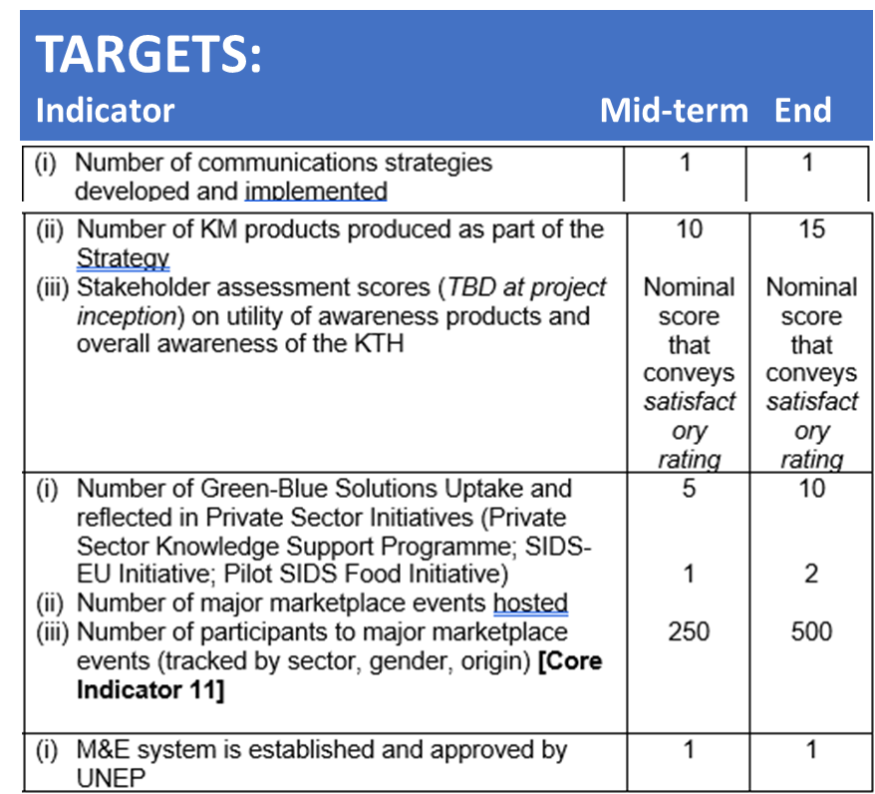
Component 3: Enhancement of sustainability and scale-up
Output 3.1.1: Marketing, Outreach and Communication Strategy and accompanying suite of knowledge products for uptake by target stakeholders
Output 3.1.2: Green-Blue Solutions Marketplace Event and Replication Strategy to sustain promotion of innovation generated by GEF Projects via the KT Hub in CSIDS and global SIDS
Output 3.1.3: Project monitoring and evaluation system (standard element within the project design framework)

Slide 29
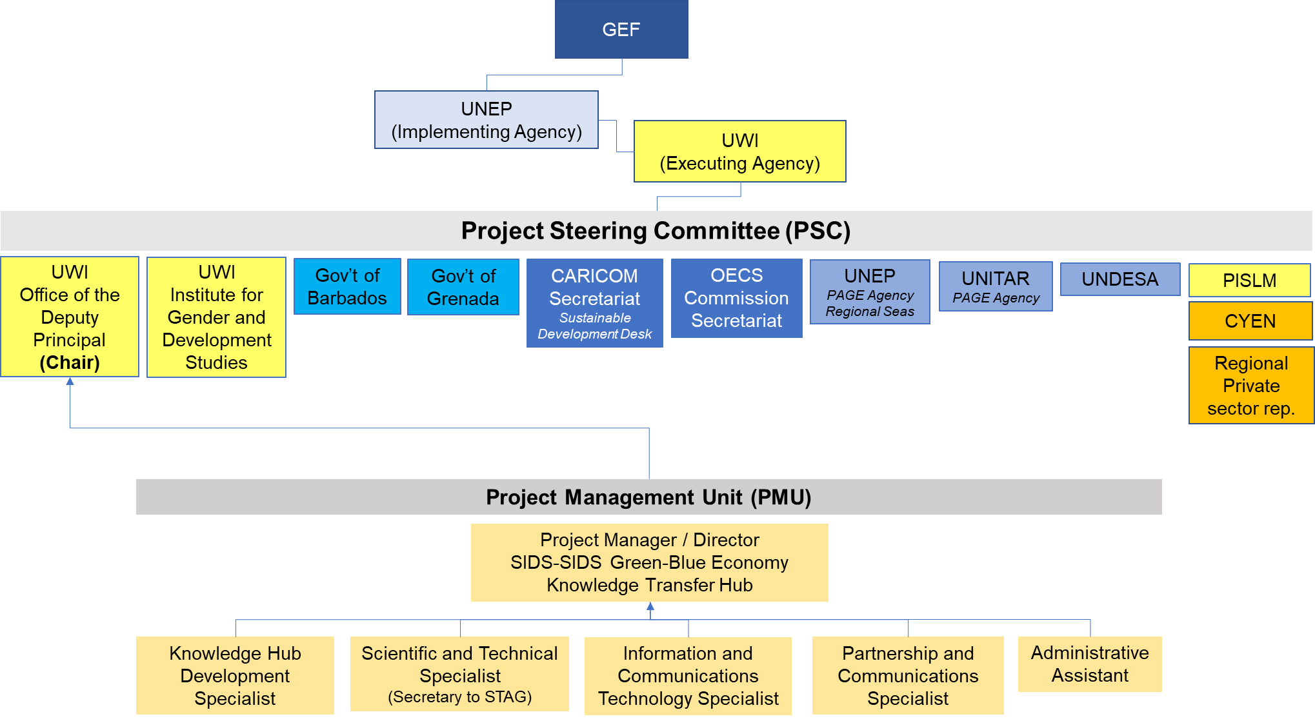
Project management arrangements

Slide 30
The End

Slide 31
What’s next for IW:LEARN on SIDS?
l
Sub-component 3.1: Twinning and dialogue activities in support of regional collaboration among SIDS via cooperation among all focal area projects and participating countries;
Sub-component 3.2: Strengthened web portal and resource catalogue to facilitate information-sharing and learning across the SIDS project portfolio in support of the SAMOA Pathway areas and beyond;
Sub-component 3.3: Training courses and other capacity-strengthening guidance developed on cross-cutting topics of relevance to SIDS;
Sub-component 3.4: Intra and inter-regional training delivered in and among SIDS regions through regional partners.
Three regional cross-cutting training workshops
Organize an inter-regional SIDS training workshop to follow up on the training and to share lessons learned and experience inter-regionally
l

Slide 32
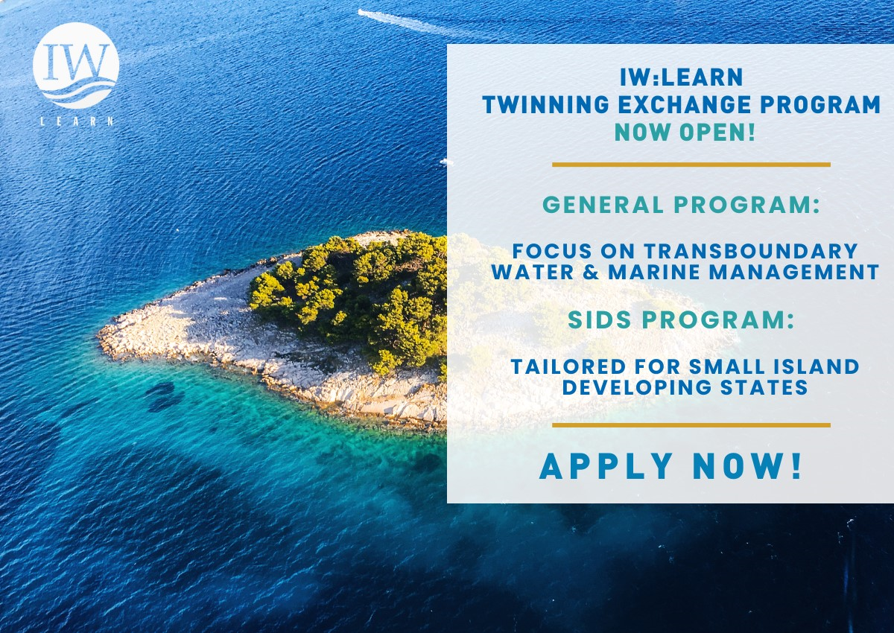
SIDS Twinning Programme is OPEN!
l
l

